Slide 1
MACHINE LEARNING MODELS

Slide 2
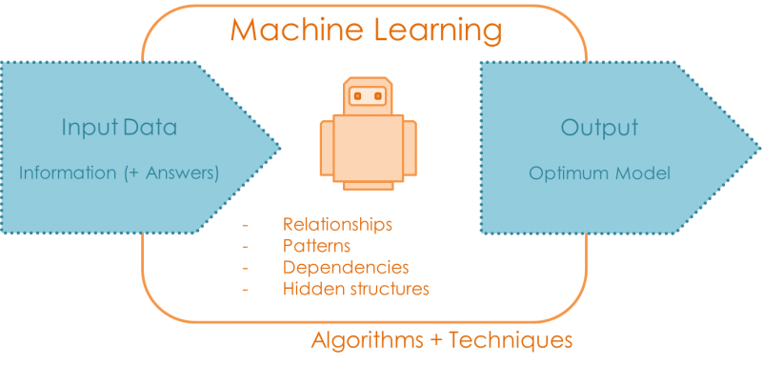
What is an ML Model?
A model is a relationship between output/response variables and its corresponding input variables in a dataset
A model can be mathematical equations, functions, and rules than link the output of the model to its inputs.

Slide 3
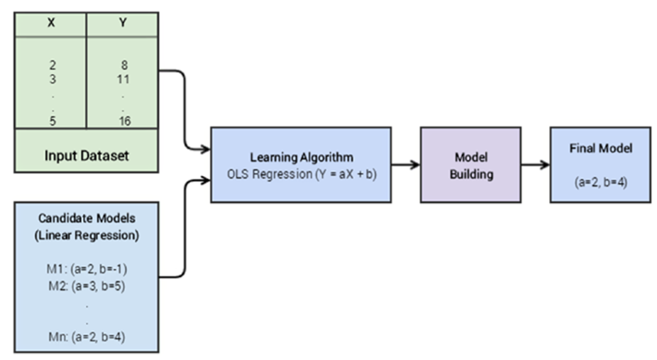
Building ML Models
Building a model is a learning process:
Learn the parameters of the model that help translate inputs into corresponding outputs with the least error
The idea is to find the right values of parameters that lead to better generalization over lots of data points

Slide 4
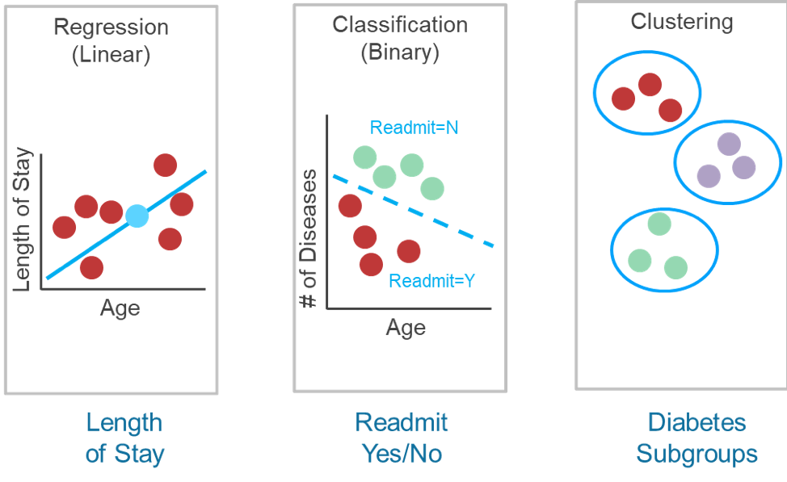
ML Model Types
Regression Models
ML Models
Classification Models
Clustering Models

Slide 5
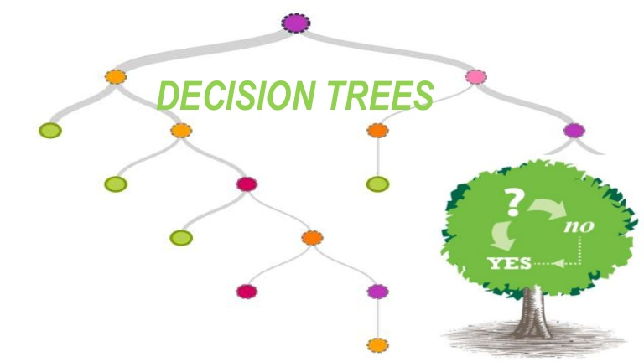

Slide 6
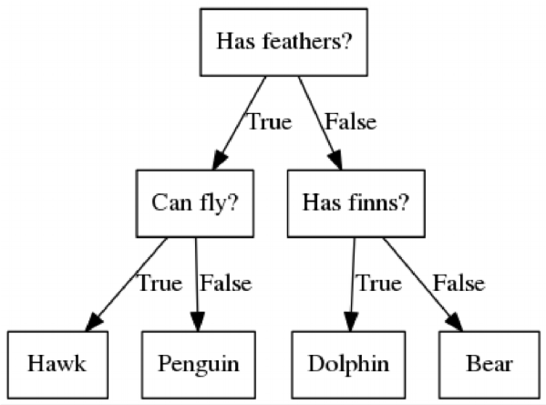
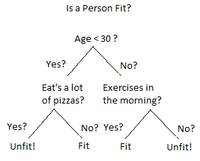
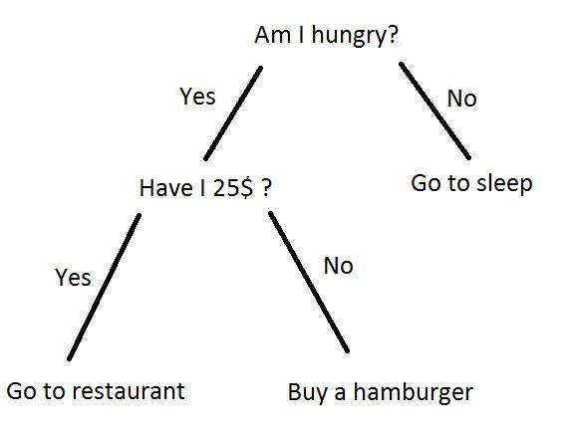
What is a Decision Tree?
A decision tree uses a tree structure to represent a number of possible decision paths and an outcome for each path.

Slide 7
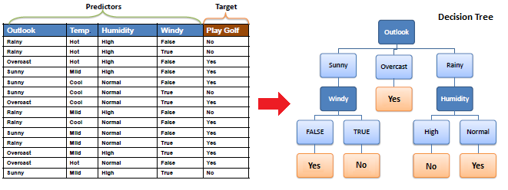
Classification Tree vs Regression Tree

Slide 8
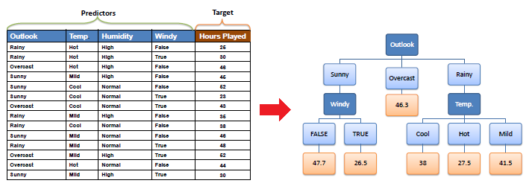
Classification Tree vs Regression Tree

Slide 9
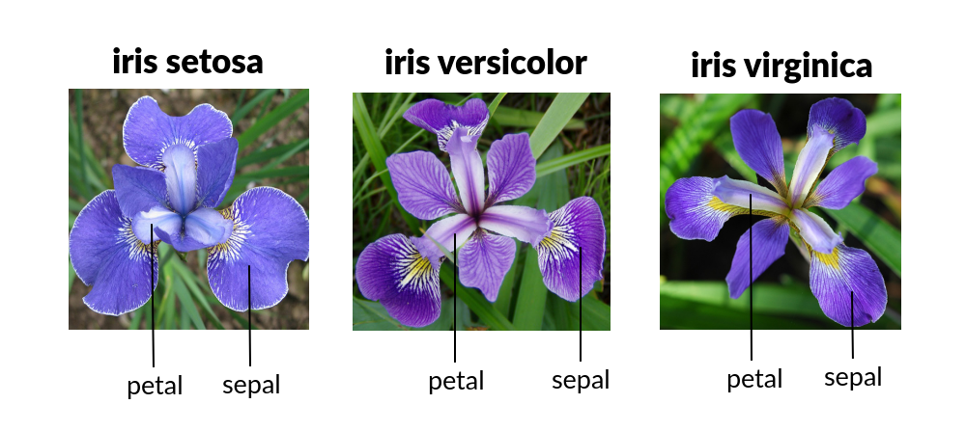
Example: Decision Tree for Iris Dataset
Classification of iris flowers : Predict iris setosa

Slide 10
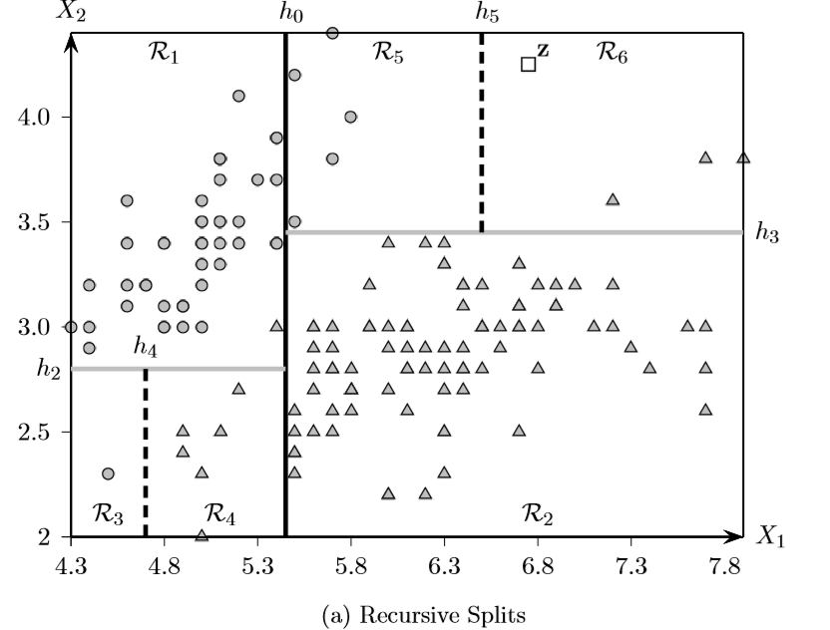
Example: Decision Tree for Iris Dataset
Recursively split heterogeneous data into smaller and more homogeneous groups
🡪 Via axis-parallel hyperplanes (h_{i})
Sepal Width
Sepal Length
Other types
Iris-setosa

Slide 11
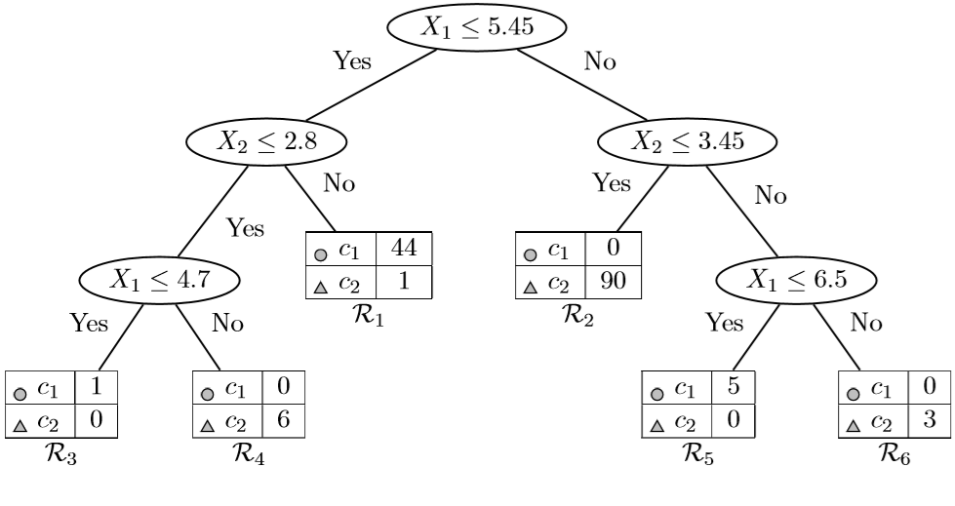
Example: Decision Tree for Iris Dataset
Sepal Width
Sepal Length
Other types
Iris-setosa

Slide 12
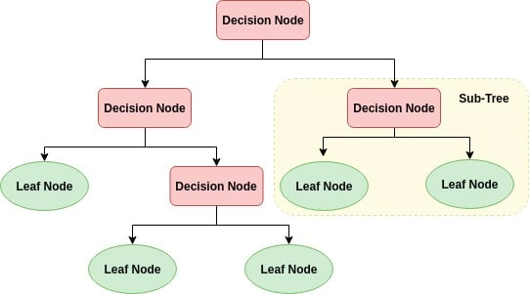
Components of a Decision Tree
Root: the first decision node
Splitting: dividing a node into two or more sub-nodes.
Decides splitting based on one feature
Predicts the outcome

Slide 13
How to Build a Decision Tree?
2 main steps:
Top down tree construction
Recursively split the training examples according to selected attributes
A greedy strategy: making locally optimal decisions about split attributes
Bottom up tree pruning
Identify and remove irrelevant branches to improve accuracy

Slide 14
How to Build a Decision Tree?
Start
Tree construction
How data should be split?
Find the best attribute test condition that leads to better accuracy.
Use objective measures for evaluating the goodness of a test attribute
Data pure?
Yes
No
Create leaf node
Determine potential splits
Find best split
Recursively repeat for each child
Split data
Tree construction flowchart

Slide 15
How to Build a Decision Tree?
Start
Tree construction
When to stop splitting?
Determine the stopping criteria: a condition to stop data splitting.
One strategy is to continue splitting until all records belong to the same class
Other criteria can be imposed: number of records, tree depth…
Data pure?
Yes
No
Create leaf node
Determine potential splits
Find best split
Recursively repeat for each child
Split data
Tree construction flowchart

Slide 16
How to Build a Decision Tree?
From a given set of attributes, many decision trees can be constructed.
DT Algorithms have been developed to induce a reasonably accurate tree in a reasonable amount of time
Constructing a decision tree is all about finding attributes that lead to a better partitioning of the dataset
Some of popular DT algorithms:
ID3 (Iterative Dichotomiser 3)
C4.5 : extension of ID3
CaRT (Classification and Regression Tree)

Slide 17
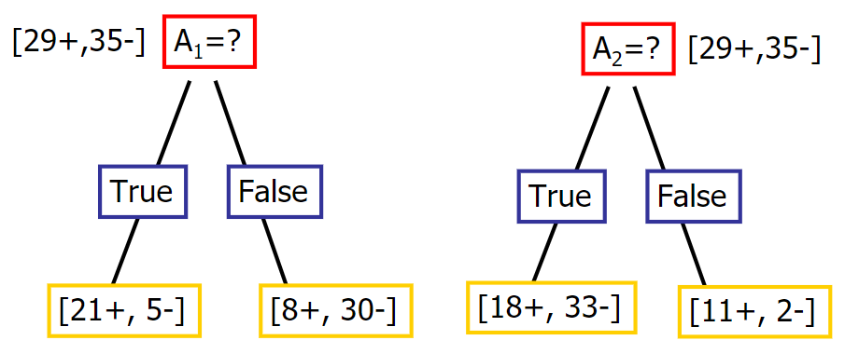
How to Select the Best Split?
How can we decide the best feature to partition data at a given depth?
Notes:
DT Algorithms have been developed to induce a reasonably accurate tree in a reasonable amount of time

Slide 18
How to Select the Best Split?
The attribute that gives the best separation or discrimination between the diﬀerent class labels.
Find test attribute for which child nodes are as “pure” as possible
At each node N, all available attributes are evaluated and ranked. The best score attribute is selected as the split-point for the node N.
Different selection measures:
Categorical target: Information Gain, Gain ratio, Gini index
Numerical target: Variance reduction, Chi-square test

Slide 19
How to Select the Best Split?
Information Gain
How much more information can be gained by splitting data?
Selection based on the degree of impurity of the class distribution of the child node
The tree splits using the feature that results in the largest information gain for a given criterion

Slide 20
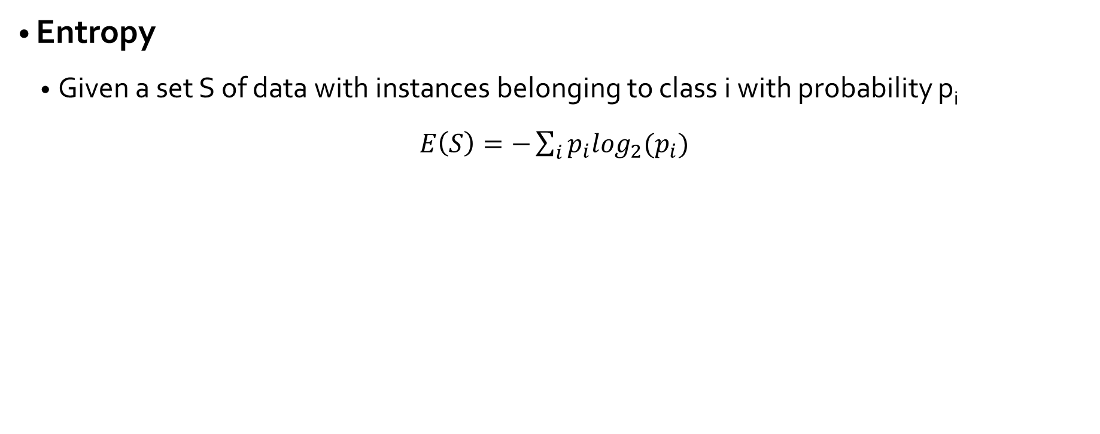
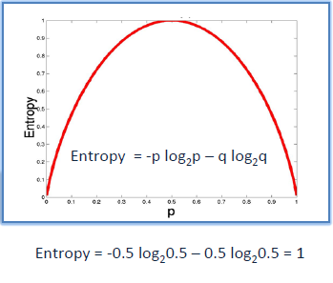
Attribute Selection Measures
Entropy will be larger when p_{i} is not close to 0 or 1🡪 samples spread across multiple classes
Entropy will be small when p_{i} is close to 0 or 1🡪 all samples belong to the same class

Slide 21
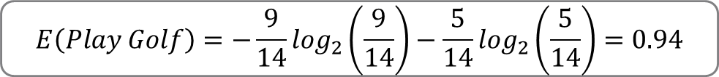
Attribute Selection Measures
How impure is the dataset?
Play Golf
Yes | 9
No | 5
High entropy🡪 heterogeneous data

Slide 22



Attribute Selection Measures
How impure are the child nodes?
Outlook
Rainy
Overcast
Sunny
Windy
Yes
Humidty
Yes | 2
No | 3
Yes | 4
No | 0
Yes | 3
No | 2

Slide 23
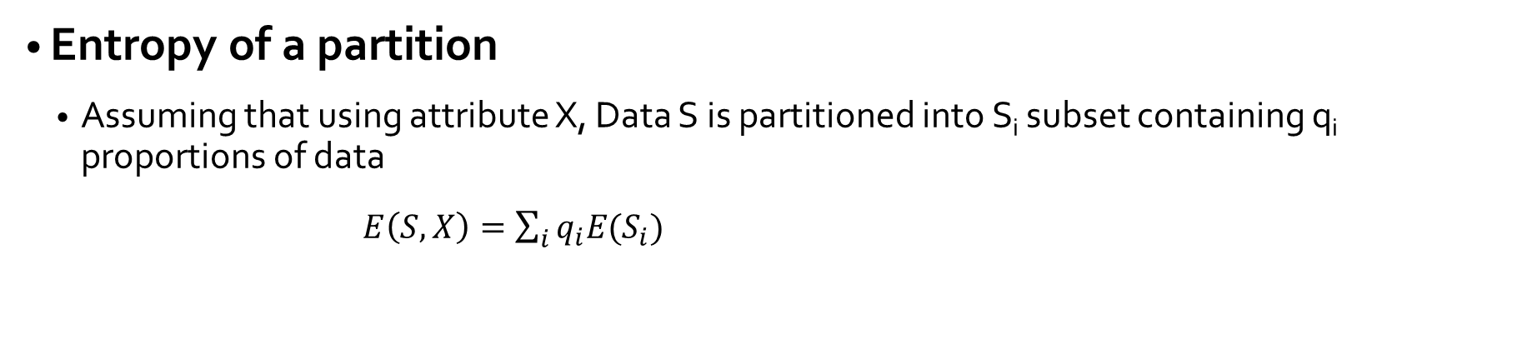
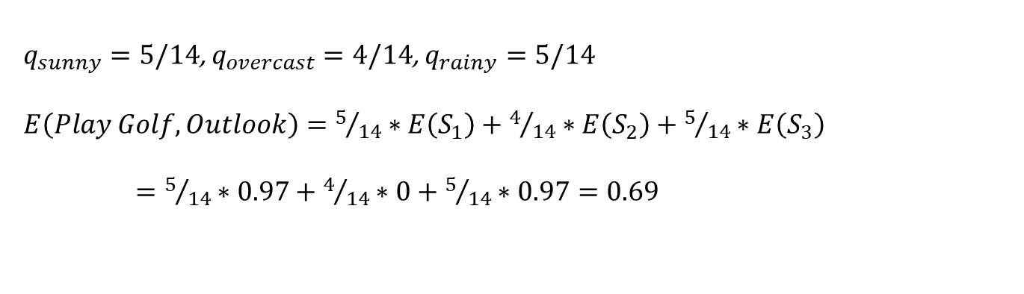



Attribute Selection Measures
Outlook
Rainy
Overcast
Sunny
Windy
Yes
Humidty
Yes | 2
No | 3
Yes | 4
No | 0
Yes | 3
No | 2

Slide 24
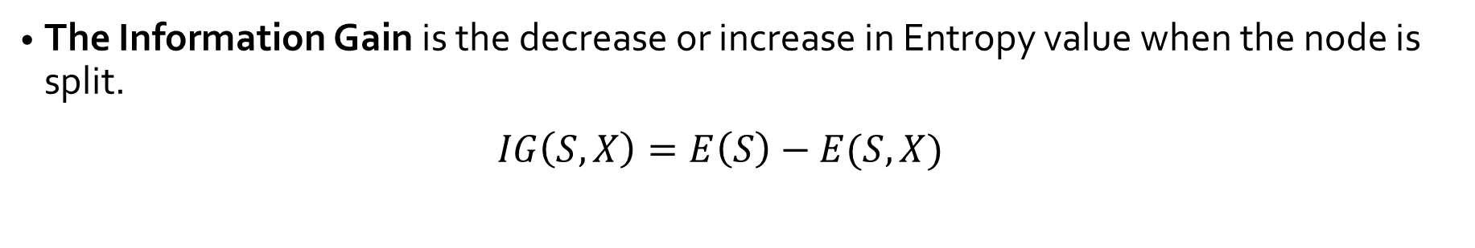
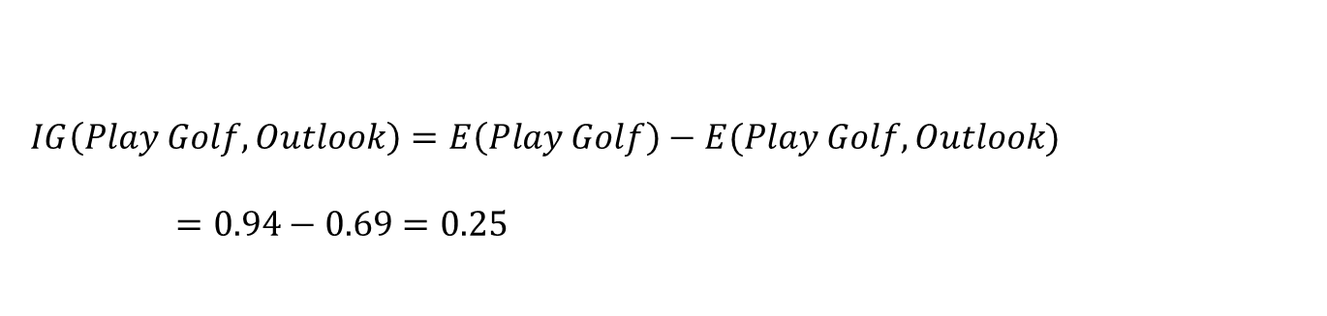
Attribute Selection Measures
Outlook
The information gain from splitting data by outlook
Rainy
Overcast
Sunny
Windy
Yes
Humidty
Yes | 2
No | 3
Yes | 4
No | 0
Yes | 3
No | 2

Slide 25
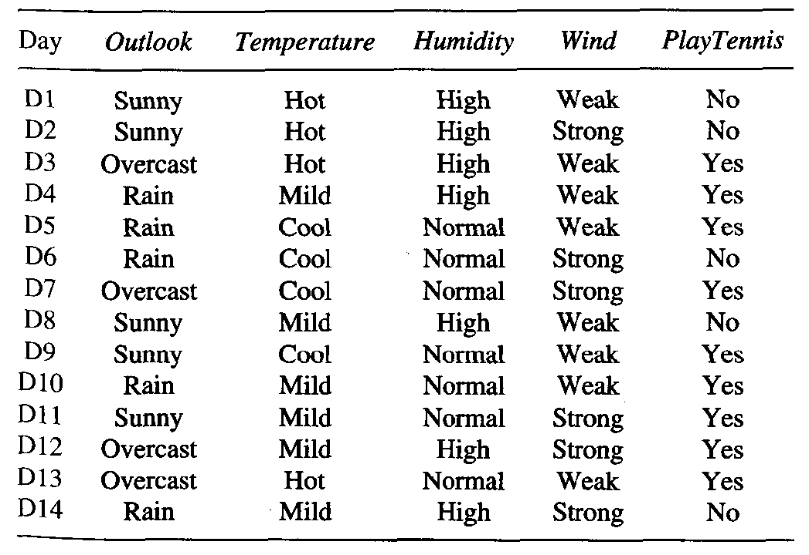
Attribute Selection Measures
Problems with Information Gain

Slide 26


Attribute Selection Measures
Problems with Information Gain
Biased towards attributes with many values
Create useless partitioning
Gain ratio normalizes the information gain using split info
Day
D1
D2
D3 …
D13
D14
No
No
Yes
Yes
No
Information gain for Day is maximal
Each leaf node is pure
v is the number of discrete values in attribute A.
D is the set of data samples
Dj is the jth partition of D

Slide 27
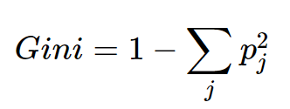
Attribute Selection Measures
Gini Index
Gini index measures the degree or probability of a particular variable being wrongly classified when it is randomly chosen.

Slide 28
What measure to use?
Ultimately, you have to experiment with your data.
Information Gain/ Entropy
Favors partitions that have small counts but many distinct values.
Algorithms: ID3 / C4.5
Gini gain/Gini Index
Favors larger partitions. Very simple to implement.
Algorithms: CaRT

Slide 29
Tree Pruning
Prevent overfitting the training data
Two pruning strategies:
Post-pruning: Remove branches from a fully grown decision tree
Based on validation set
Pre-pruning: Stop tree growing when information becomes unreliable
Post-pruning is more successful

Slide 30
Pre-Pruning
Early Stopping Rule
Specify some stopping criteria to limit tree growing
The typical stopping
When all instances belong to the same class
When all the attribute values are the same
Restrictive conditions
Stop when the number of instances are less than a threshold
Stop when the depth of the tree reach a certain threshold
Stop when there is no information gain

Slide 31
Post-Pruning
Grow the decision tree entirely then trim the nodes in a bottom-up fashion
Prune only if it reduces classification error (reduce-error pruning)
Two post-prunning operations:
Subtree replacement
Subtree raising

Slide 32
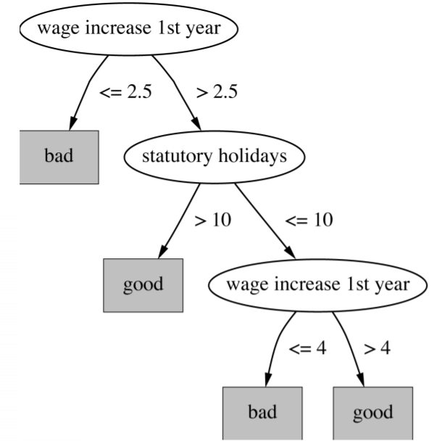
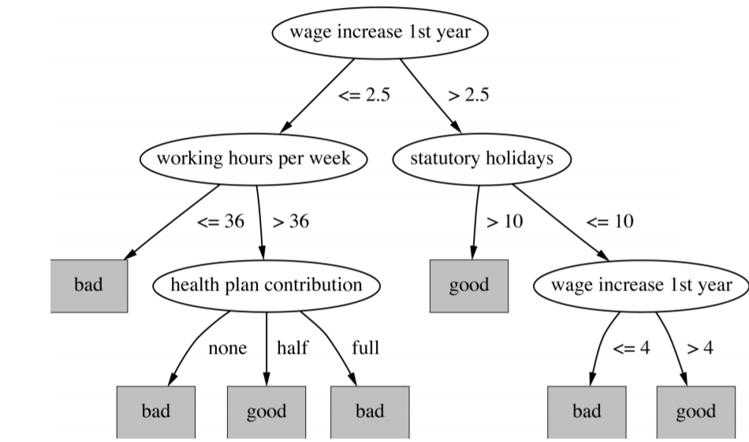
Post-Pruning
Subtree replacement

Slide 33
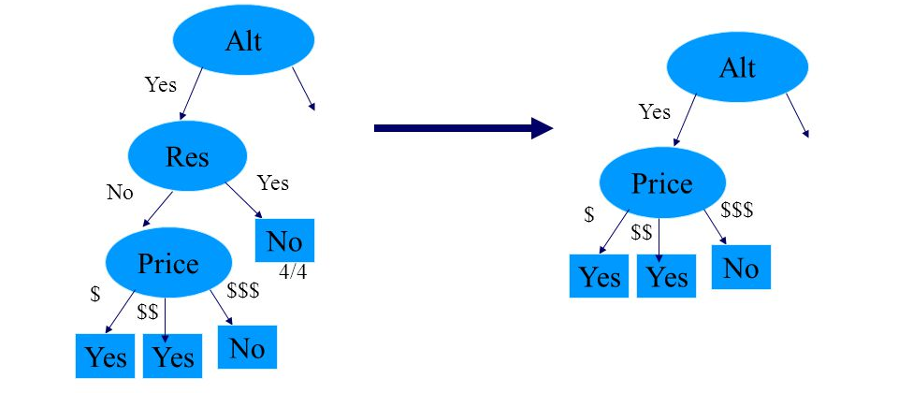
Post-pruning
Subtree raising

Slide 34
Summary
Pros
A white box model: easy to interpret and to understand. Perfect for visual representation
Requires little data preparation
High inference speed
Cons
Easy to overfit
Unstable. A little change in the data changes the structure of the tree
Decision boundaries restricted to axis-parallel
Greedy algorithm 🡪 computation of globally optimal tree is practically impossible.

